Slide 1

Web accessibility and you
Maximising the opportunities
of an accessible website
Millhouse disability services support

Slide 2

What is web accessibility?
Practice of removing barriers that prevent interaction with or access to websites by people with disabilities

Slide 3
Put simply
It’s making your website easy to use for people with disabilities
Vision
Hearing
Motor
Cognitive

Slide 4
Why make your website accessible
Increases your market and makes you competitive
Identifies you as a organisation caring about everyone
Reduces legal risk

Slide 5
Increases your market
20% of people in Australia identify as having a disability
If people can't access your website because they have an impairment they will go to your competitor

Slide 6
Build for the extremes
Also helps other users and will make your site more usable. It's not just permanent disabilities, but also temporary impairments
Broken arm
Parent holding a baby
Time poor university student

Slide 7
Good corporate citizen
You're making it known that you care about everyone visiting your website regardless of impairment, you're being inclusive and it sends a great message

Slide 8
Reduces risk
Having an inaccessible website can increase your risk of legal action against the Disability Discrimination Act
Although this is very unlikely, it can happen

Slide 9
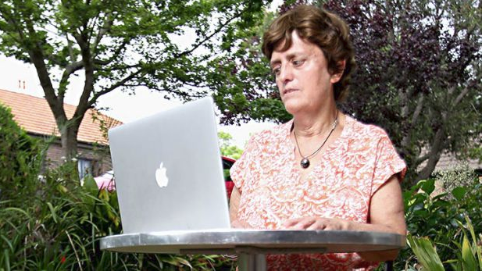
The Coles supermarket case
This is Gisele

Slide 10

Online shopping
Gisele is vision impaired and wanted to buy her groceries online as it would be easier for her
The Coles website wouldn’t work correctly with her screen reader

Slide 11
Breaching the DDA
Numerous requests to fix their website weren't addressed
A complaint was lodged with the Human Rights Commission to attempt to reach a compromise

Slide 12
The outcome
Reluctantly Gisele took Coles to court for being in breach of the Disability Discrimination Act
- Coles settled out of court

Slide 13
So how do PWD use websites?
Assistive technology is an umbrella term to describe software or hardware which may be used to interact with your website
- Screen reader
- Screen magnifier
- Voice dictation

Slide 14
Screen reader
Reads a website audibly
Announces text, links, images and many other onscreen elements
A user can move around a webpage audibly and hear sections being announced

Slide 15
Screen reader navigation
Because a screen reader can't visually see your website it relies instead on the HTML code
If the code is poorly written it can make it very difficult and in some instances impossible for a screen reader user

Slide 16
Checking accessibility
Checked against WCAG 2.0
WCAG 2.0 is an international best practice standard to assess how accessible a website is

Slide 17
What is WCAG 2.0?
Web Content Accessibility Guidelines 2.0
Now updated to WCAG 2.1
3 levels A, AA, AAA

Slide 18
WCAG 2.0 details
It’s a set of technical specifications describing how best to structure your website
It's complex, and often contradictory

Slide 19
Easy accessibility checks
For every image on your website provide an ALT text description
Make sure headings are in a sequential order
Make sure everything on your site is keyboard accessible
Every link has clear and understandable text

Slide 20
1. ALT text on images
Screen readers announce the ALT text description. It’s a description of the image, not a literal description
Describe the image as if you were describing the image to a friend

Slide 21

ALT text example
For every image on your website provide ALT text
<img src="image.jpg" alt="Parliament
house illuminated with different
coloured words during the enlighten
festival">

Slide 22

ALT text exception
If the image is decorative only provide blank ALT text
<img src="image.jpg" alt="">

Slide 23
2. Headings
Structure a page
Assistive technology users can move around a page via the headings

Slide 24
Headings
If headings are nested incorrectly or missing, it makes it very hard for a user to understand the structure of the page

Slide 25
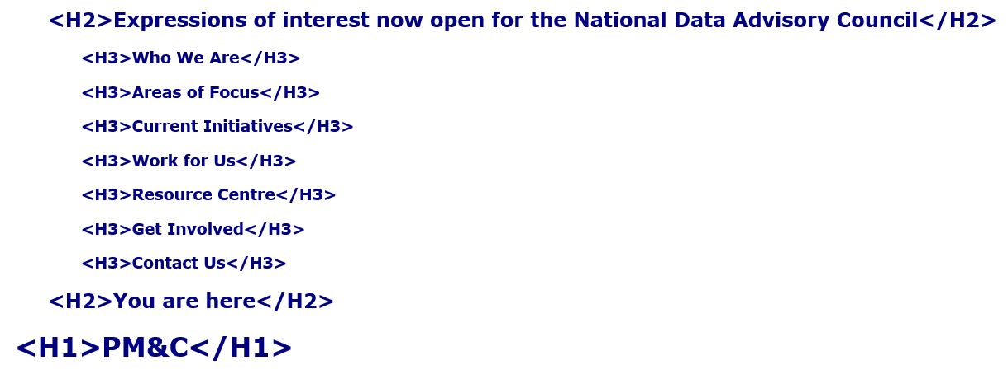

Headings examples
Only one <h1> heading element
Followed by <h2>, <h3>, <h4>

Slide 26
3. Keyboard control
Some people don’t use a mouse and instead rely on the keyboard to move around the webpage

Slide 27
Keyboard control
Try it yourself
Can you reach every part of your site from the keyboard?

Slide 28
Keyboard control
If you find you have to use a mouse on parts of your website it probably means keyboard users will have difficulties

Slide 29
4. Clear link text
All links on the page make sense when read on their own

Slide 30
Unclear link text
"Canberra is cold in winter, click here for todays weather"

Slide 31
Unclear link text
The problem is screen reader users will not hear the text surrounding the link when they tab to it
"click here"
The link isn't understandable

Slide 32
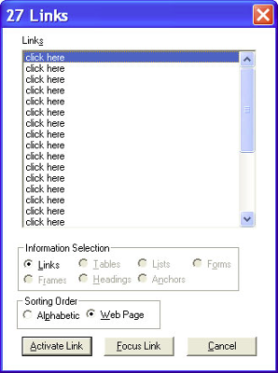
Unclear link text
Also, screen readers can display all links on the page separately in a window

Slide 33
Unclear link text
Ensure each link makes sense when read individually
"todays weather"

Slide 34
Easy checks
These four checks are easy to fix, however it's just scratching the surface of making a website accessible

Slide 35
Good testing
It's a mixture of manual and automatic testing with several programs by an expert reviewer

Slide 36
Accessibility auditing
Is a thorough check of your site with a report produced explaining problems, and giving you solutions to fix
Automatic testing + Manual testing + Expert Review = Better website accessibility

Slide 37
Be aware
A lot of cowboys who will attempt to confuse you with detail
Reports which place too much emphasis on easy checks
Very expensive reports
Plugins which make your site accessible
Claims of 100% compliance against WCAG 2.0
All of these claims are untrue

Slide 38
It doesn’t have to be confusing
We provide obligation free advice
We produce affordable audit reports
Can help with fixing your site

Slide 39
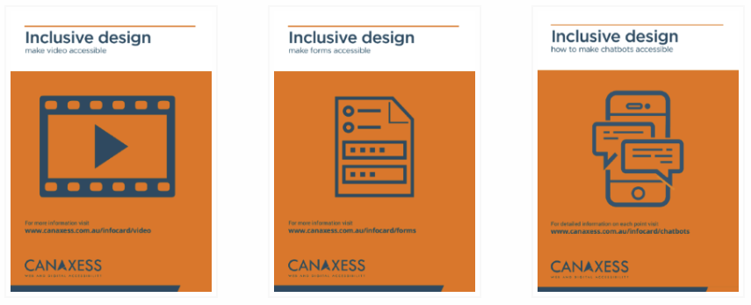
For more information
Get free information cards from www.canaxess.com.au/infocard/

